Slide 1
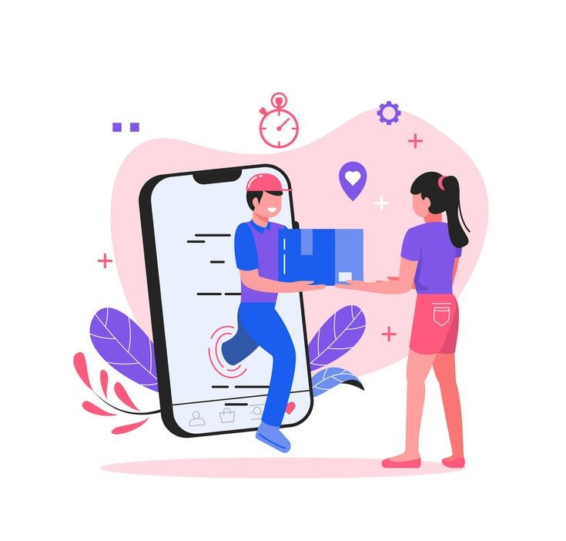
ShopEZ- E-commerce application – using MERN

Slide 2
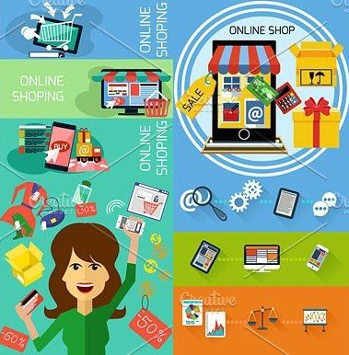
Introduction :
Welcome to Shop-EZ, your ultimate e-commerce solution designed to make shopping effortless, efficient, and enjoyable. Shop-EZ combines cutting-edge technology with user-friendly design to offer a seamless shopping experience for both buyers and sellers.

Slide 3
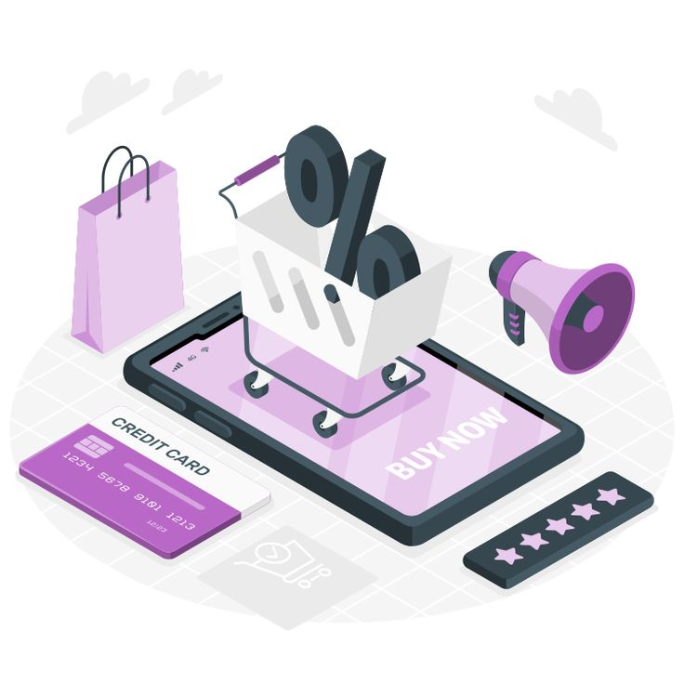
Overview of E- Commerce Applications
E-commerce applications facilitate online transactions and provide a platform for businesses to reach customers. Key features include product listings, shopping carts, and payment gateways. A successful e-commerce app must prioritize user experience and scalability.

Slide 4
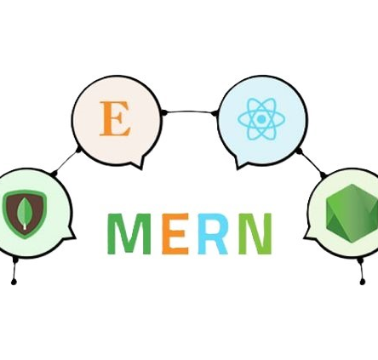
MERN STACK :
The MERN stack consists of MongoDB, Express.js, React, and Node.js. This combination allows developers to build powerful and scalable e-commerce applications using JavaScript throughout the stack. Understanding each component's role is essential for creating a cohesive and efficient application

Slide 5
TOOLS:
01
03
02
04
MongoDB:
Express.js:
NoSQL database for storing application data.
A backend framework for building web APIs.
React:
Node.js:
A frontend library for creating dynamic user interfaces.
A runtime for executing JavaScript on the server

Slide 6
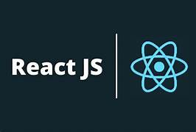
Frontend Development with React:
React is a powerful JavaScript library for building user interfaces. It allows for the creation of dynamic and responsive components, making it perfect for ecommerce sites. Understanding state management and component lifecycle is crucial for effective development

Slide 7
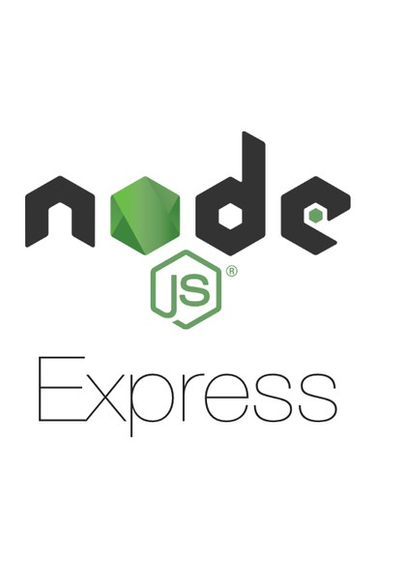
Building the Backend with Express.js& Node js:

Slide 8
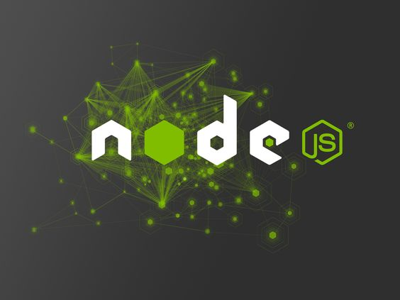
NODE js
Node.js is a runtime environment that allows you to run JavaScript code on the server-side, outside of the browser. It uses Google's V8 JavaScript engine (the same engine that powers Google Chrome), making it fast and efficient for building scalable applications, especially real-time and network-heavy services.

Slide 9
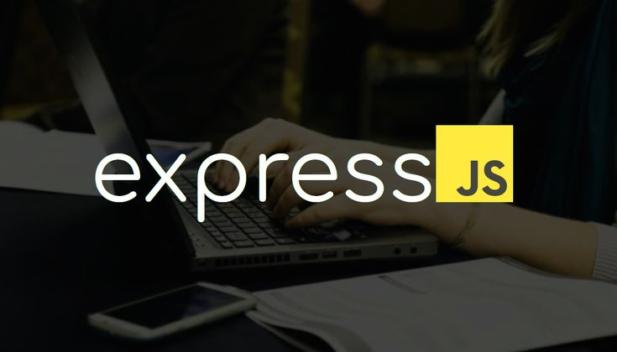
EXPRESS
Express.js is a web application framework for Node.js that simplifies the process of building robust APIs. It allows developers to handle routing, middleware, and HTTP requests efficiently, making it ideal for managing e-commerce functionalities like user authentication.

Slide 10
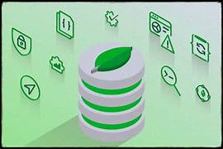
Setting Up MongoDB
MongoDB is a NoSQL database that stores data in JSON-like documents. It provides flexibility and scalability for e-commerce applications. Setting up MongoDB involves creating a database, defining schemas, and establishing connections with your application.

Slide 11

Creating a RESTful API
A RESTful API is essential for connecting the frontend and backend of your ecommerce application. It enables CRUD operations (Create, Read, Update, Delete) on resources like products and orders, ensuring smooth data flow between client and server.

Slide 12
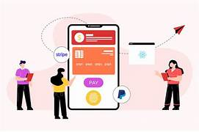
Integrating Payment Gateways
Integrating payment gateways is crucial for e-commerce applications to process transactions securely. Services like Stripe and PayPal offer APIs that can be easily integrated into your MERN stack application, ensuring a seamless checkout experience for users.

Slide 13
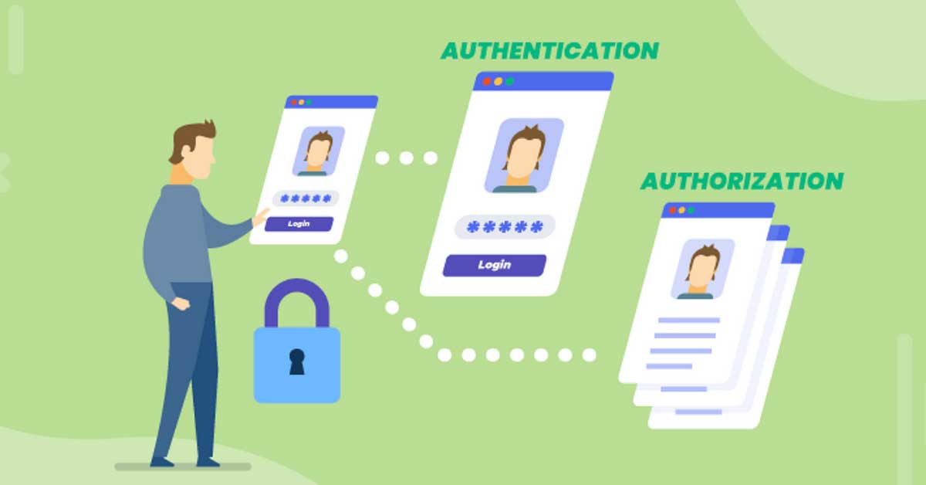
Implementing User Authentication
User authentication is vital for any ecommerce application. Implementing JWT (JSON Web Tokens) or OAuth can secure user sessions and protect sensitive data. Ensuring a smooth login and registration process enhances user experience and trust.

Slide 14

Testing and Debugging
Testing is essential to ensure the reliability of your e-commerce application. Use tools like Jest and Mocha for unit testing, and Postman for API testing. Debugging helps identify and resolve issues before deployment, ensuring a smooth user experience.

Slide 15
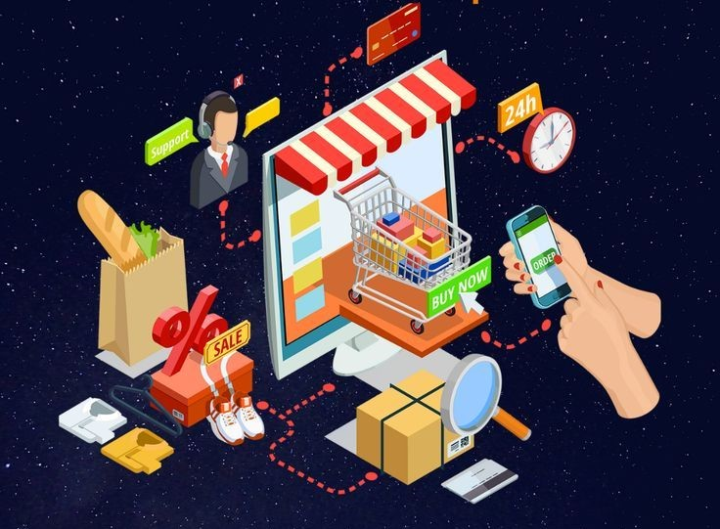
Deployment Strategies
Deploying your MERN stack application can be done using services like Heroku, AWS, or DigitalOcean. Consider factors like scalability, performance, and cost when choosing a hosting service. Proper deployment ensures your application is accessible to users

Slide 16
Conclusion and Future Prospects
Building a scalable e-commerce application with the MERN stack offers flexibility and efficiency. As technology evolves, staying updated with the latest trends and best practices will help you enhance your application and meet user demands effectively.

Slide 17

PRESENTED by:
Praveen kumar R 311421205065
Sreenivasan VS 311421205085
Karthikeyan M 311421205302
Thirumurugan MP 311421205096

